Slide 1
Best practices for running Oracle Databases under z/VM
z/VM workshop 2016
Sam Amsavelu
Oracle on z Architect
IBM ISV & Channels Technical Sales – Oracle
samvelu@us.ibm.com

Slide 2
Copyright and Trademark Information
For IBM – can be found at
      http://www.ibm.com/legal/us/en/copytrade.shtml
For Oracle – can be found at
http://www.oracle.com/us/legal/index.html

Slide 3
Agenda
Oracle Database architecture
CPU
Memory
I/O
Network
High Availability
Source: If applicable, describe source origin

Slide 4
Oracle Database architecture
Relational database management system (RDBMS)
Data is perceived as rows and columns
Instance and Database
Database is collection of
  Data files
  Redo log files
  Control files
Instance is a mean to access a database and consists of
  Processes
  Threads
  Memory structures
Instance always opens one and only one database

Slide 5
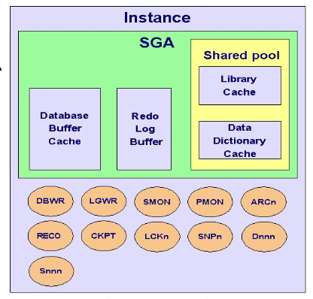
Oracle Database architecture
An Oracle instance consists of memory structures (SGA) and background processes (DBWn, LGWR, CKPT, SMON, PMON, MMON and optionally ARCn, Dnnn, Snnn etc.)

Slide 6
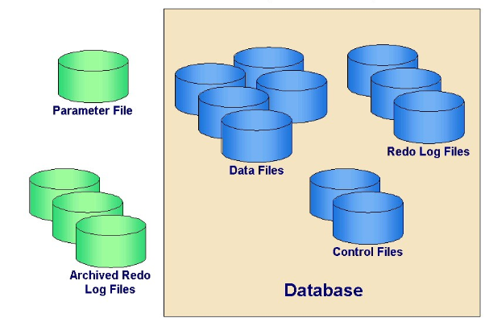
Oracle Database architecture
Database consists of the following files

Slide 7
Oracle Database architecture challenges
Typically hundreds of databases in an enterprise
Many implement one database per server per application
Waste of resources (white space) and lot of human resources requirements
Even if we combine multiple databases on one server still there are multiple database instances
  They do not share background processes,
  System and process memory, or Oracle metadata
Server consolidation is a biggest challenge with this architecrure

Slide 8
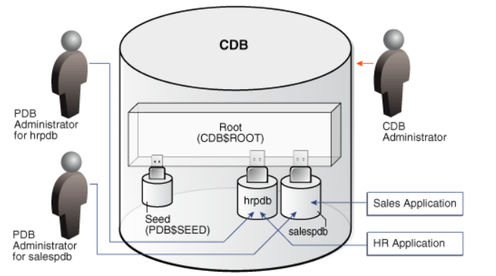
Oracle Database multitenant architecture
12c Database multitenant architecture
  Container Database
  Pluggable Databases

Slide 9
Oracle Database multitenant architecture
Container Database
  very similar to a conventional Oracle database, as it contains most of the working parts (controlfiles, datafiles, undo, tempfiles, redo logs etc.).
  It also houses the data dictionary for those objects that are owned by the root container and those that are visible to all PDBs.
Pluggable Database (PDB) :
  PDB contains information specific to itself and it is just made up of datafiles and tempfiles to handle it's own objects.
  This includes it's own data dictionary, containing information about only those objects that are specific to the PDB.

Slide 10
Oracle Database multitenant architecture advantages
High density database consolidation per server
Patch and upgrade one multitenant container database
Backup one multitenant container database
Easy to move a database from one server to another and easy to clone
Common SGA and common background processes
CPU resources can be controlled by resource plans
But still not many customers have adapted the technology
Note:
  Oracle will be deprecating the non-cdb databases

Slide 11
Agenda
Oracle Database architecture
CPU
Memory
I/O
Network
High Availability
Source: If applicable, describe source origin

Slide 12
Reduce Linux RPM’s to What’s Needed
Helps reduces the Disk space & the Number of Linux services created.
Reduces the software updates/bug/security updates that are required.
Use the Oracle RPM checker
  Requirements for Installing Oracle Database 12c on RHEL 6 on IBM: Linux on System z (s390x) (Doc ID 1574413.1)
  Requirements for Installing Oracle Database 12c on SLES 11 on IBM: Linux on System z (s390x) (Doc ID 1574414.1)
Oracle 12c database no longer requires the 31-bit s390 libraries
  Oracle client still requires 31-bit libraries (not typically installed on DB server)

Slide 13

Turn off Unneeded Services
Keep the golden image as lean as possible in terms of processor usage, some of these services can be turned off with chkconfig command:
Red Hat 6.8
# chkconfig iptables off
# chkconfig ip6tables off
# chkconfig auditd off
# chkconfig abrtd off
# chkconfig atd off
# chkconfig cups off
# chkconfig mdmonitor off
SLES 11 SP4
# chkconfig fbset off
# chkconfig network-remotefs off
# chkconfig postfix off
# chkconfig splash off
# chkconfig splash_early off
# chkconfig smartd off
# chkconfig xinetd off
Source: http://www.redbooks.ibm.com/abstracts/sg248147.html
The Virtualization Cookbook for IBM z Systems Volume 2: Red Hat Enterprise Linux Server 7.1, SG24-8303
The Virtualization Cookbook for IBM z Systems Volume 3: SUSE Linux Enterprise Server 12, SG24-8890

Slide 14
Linux paging / swappiness
Default Linux swappiness setting of 60 Linux does proactive paging
  Recommendation: set swappiness to lower value
  /etc/syctl.conf add vm.swappiness=5
  Avoids any unnecessary waits for swap

Slide 15

Swap Sizing Oracle with Linux on System z
Example of VDISK for 1st and or 2nd Level Swap with higher priority and then DASD as a lower priority swap in case of an unexpected memory pattern
Oracle requires 500mb of free swap to relink! (OS Upgrades etc.)
May want to recycle the swap from time to time to free swap slots (check swapcache in /proc/meminfo)
  Ensure there is enough memory (e.g. at night)
  drop caches
  swapoff / swapon
Notes:
Memory sizing with 11gR2 very important. I had one customer send me the results that there 10gR2 to 11gR2 upgrade used about
200 mb more memory between the releases.
AWR reports to get sizing
Virtual over commit for z/VM environments guidelines 1-1.5 to 1 and 2 to 3:1 for Development.
For my environments where were testing lots of different versions/features – not really using all the memory on each of my systems
So z/VM is great to have access to lots of different environments – with out a lot of cost.
One customer I’m working is new to Oracle RAC – so it’s great for them in a sandbox to try things out,
Swap configuration is very important. VDISK is a capability for system z whereby you can swap to memory.
The VDISK is not allocated until Linux attempts to swap, There is, however, a good case for using multiple swap disk devices with
different priorities. If multiple swap devices with different priority are available,Linux will attempt to fill the one with highest priority before using the next device.
The algorithms for allocating pages on swap devices in Linux cause the active area to “sweep” over the device (this reduces seek times on the device and
increases the ability of Linux to build long I/O chains).This means that over time the entire swap device has been referenced. In the
case of VDISK, this means that CP has to provide memory for the entire VDISK,even though the Linux virtual machine might only need a small portion of the
VDISK at any given time.

Slide 16
Large Linux Guests - Write Improvements
The following settings may be relevant when tuning for database workloads for large Linux guests. (/etc/sysctl.conf) with write performance.
vm.dirty_ratio=10 - Maximum percentage of dirty system memory (default 40).
vm.dirty_background_ratio = 3 - Percentage of dirty system memory at which background writeback will start (default 10).
vm.dirty_expire_centisecs = 500 - Duration after which dirty system memory is considered old & eligible for writeback (default 3000) vm.dirty_writeback_centisecs=100 - ( default 500)
vm.vfs_cache_pressure =200 - Helps performance of backups to disk
vm.dirty_expire_centisecs = 3000 - Default is 500
Source: https://www.SUSE.com/support/kb/doc.php?id=7010287
Effects particularly large Linux Guests > 8GB that write to NFS devices. (e.g. RMAN backups)
Notes:
vm.dirty_ratio
Maximum percentage of dirty system memory (default 40).
When this percentage of memory is hit, processes will not be allowed to write more until some of their cached data is written out. This ensures that the ratio is enforced. By itself, that can slow down writes noticeably, but not tremendously. However, if an application has written a large amount of data which is still in the dirty cache, and then issues a "sync" command to have it all written to disk, this can take a significant amount of time to accomplish. During that time, some processes may appear stuck or hung.
vm.dirty_background_ratio
Percentage of dirty system memory at which background writeback will start (default 10).
"Background" writes are kicked off to get writing done even when the application isn't forcing a sync, and even if the dirty_ratio has not yet been reached. The goal of this setting is to keeps the dirty cache from growing too large. When reducing dirty_ratio to 10, it can be common to reduce dirty_background_ratio to 5 or lower. Rule of thumb: dirty_background_ratio = 1/4 to 1/2 of the dirty_ratio.

Slide 17
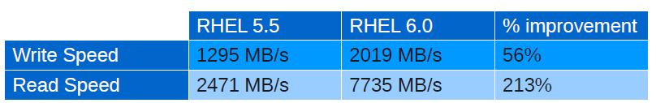
OS Level Currency
Significant Performance & Security Improvements when upgrading OS Distribution levels:
Red Hat Memory Performance:
Source Red Hat - A Performance Comparison Between RHEL 5 and RHEL 6 on System z

Slide 18
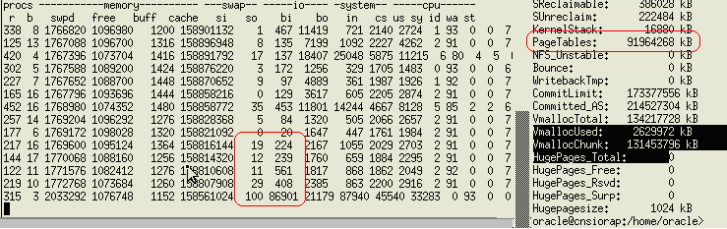
Linux Huge Pages
Consider Using Linux Huge Pages for Oracle Database Memory
  →In general 10-15% can be gained by the reduction in CPU usage as well as having a lot more memory for applications that would be consumed in Linux Page Tables…
Notes:
Huge pages is all or nothing with Oracle – either the whole SGA is huge page or everything is 4k
Linux will convert HugePages to 4K pages

Slide 19
Oracle currency
During Oracle binary installation avoid selecting default components, choose only whichever are necessary
  As an example DB installed with NO options
    The "gettimeofday" function is called 300 times every 15 seconds.
  DB installed with all options : (java, xml, Text, spatial, APEX, etc ....... )
    The "gettimeofday" function is called 1500 times every 15 seconds.
Try to apply the latest Oracle patches as practical as possible
Oracle April PSU 2016: Security & Bug/Performance Fixes

Slide 20
Oracle 12c Trace File Analyzer Disable
Trace File Analyzer Collector (TFA): collects log and trace files from all nodes and products into a single location.
  Written in Java with its own JVM
  Large memory footprint for the heap etc.
  Can be disabled with a single command
  Note: next time you run rootcrs.pl (patching for example) it may reinstall itself.
Stop TFA
# /etc/init.d/init.tfa stop
Start TFA
# /etc/init.d/init.tfa start
Stop and removes related inittab entries
# /etc/init.d/init.tfa shutdown

Slide 21
12c Cluster Verification Utility (CVU) - Disable
Cluster Verification Utility (CVU):
The CVU tool automatically runs, pointing out configuration issue.
In Oracle 12.1.0.2, scheduled to run automatically every time the cluster is started and periodically after that.
The CVU itself and checks use CPU and RAM resources, and are better run manually when such resources are limited.
It’s a quick removal
# crs_stat -t
Name Type Target State Host
------------------------------------------------------------
ora....ER.lsnr ora....er.type ONLINE ONLINE clone01
ora....N1.lsnr ora....er.type ONLINE ONLINE clone01
ora....N2.lsnr ora....er.type ONLINE ONLINE clone01
ora....N3.lsnr ora....er.type ONLINE ONLINE clone01
ora.OCR2.dg ora....up.type ONLINE ONLINE clone01
ora.asm ora.asm.type ONLINE ONLINE clone01
ora....SM1.asm application ONLINE ONLINE clone01
ora....01.lsnr application ONLINE ONLINE clone01
ora....e01.ons application ONLINE ONLINE clone01
ora....e01.vip ora....t1.type ONLINE ONLINE clone01
ora.cvu ora.cvu.type ONLINE ONLINE clone01
ora....network ora....rk.type ONLINE ONLINE clone01
ora.oc4j ora.oc4j.type OFFLINE OFFLINE
ora.ons ora.ons.type ONLINE ONLINE clone01
ora.scan1.vip ora....ip.type ONLINE ONLINE clone01
ora.scan2.vip ora....ip.type ONLINE ONLINE clone01
ora.scan3.vip ora....ip.type ONLINE ONLINE clone01
# srvctl stop cvu -force
Source: Marc Fielding http://www.pythian.com/blog/slimming-down-oracle-rac-12cs-resource-footprint/

Slide 22
Oracle 12c OC4J – Ensure Disabled
OC4J:
Every Oracle 12c grid install contains OC4J
Linux on System z oc4j is disabled by default.
Ensure oc4j is disabled.
# crs_stat -t
Name Type Target State Host
------------------------------------------------------------
ora....ER.lsnr ora....er.type ONLINE ONLINE clone01
ora....N1.lsnr ora....er.type ONLINE ONLINE clone01
ora....N2.lsnr ora....er.type ONLINE ONLINE clone01
ora....N3.lsnr ora....er.type ONLINE ONLINE clone01
ora.OCR2.dg ora....up.type ONLINE ONLINE clone01
ora.asm ora.asm.type ONLINE ONLINE clone01
ora....SM1.asm application ONLINE ONLINE clone01
ora....01.lsnr application ONLINE ONLINE clone01
ora....e01.ons application ONLINE ONLINE clone01
ora....e01.vip ora....t1.type ONLINE ONLINE clone01
ora.cvu ora.cvu.type OFFLINE OFFLINE
ora....network ora....rk.type ONLINE ONLINE clone01
ora.oc4j ora.oc4j.type OFFLINE OFFLINE
ora.ons ora.ons.type ONLINE ONLINE clone01
ora.scan1.vip ora....ip.type ONLINE ONLINE clone01
ora.scan2.vip ora....ip.type ONLINE ONLINE clone01
ora.scan3.vip ora....ip.type ONLINE ONLINE clone01

Slide 23
Have a procedure to identify the cpu consuming processes
Gather INDIVIDUAL PROCESS CPU usage statistics (all processes) at five minute intervals
Summarize Top 5 or 10 CPU usage processes by each Server for an hour, every hour, for each day
Store it in Oracle tables and analyze for patterns and unusual changes
Target those processes to reduce the CPU usage
The compression, RMAN seems to be high CPU usage
Try to implement incremental RMAN backup

Slide 24
Some process to watch out for CPU consumption are:
ZIP, GZIP, BZIP, etc.
SNMPD
OEM Agent
KSWAPD0
BPBKAR
GREP
TAR

Slide 25
Context switches
Depends
Test Condition | Number of Processes | Processes with threads | CS with 1 virtual processor | CS with 2 virtual processors
zero Database | 99 | 152 | ~ 25 | ~ 25
One Database | 120 | 175 | ~ 2000 | ~ 2000
Two Databases | 141 | 192 | ~ 3000 | ~ 4000
Three Databases | 162 | 214 | ~ 4000 | ~ 5800

Slide 26
Agenda
Oracle Database architecture
CPU
Memory
I/O
Network
High Availability
Source: If applicable, describe source origin

Slide 27
Memory Sizing Oracle with Linux on System z Linux
Oracle recommends 4GB for all Linux Platforms, smallest we would suggest is 2GB of Virtual Memory for a Single Oracle 11g/12c instance.
Right Size the Virtual Memory based on what is needed:
  All SGA’s (including ASM) – consider Large Pages
  Oracle PGA’s (not eligible for Large Pages – small pages)
  User Connections to the database (4.5mb per connection – small pages)
  Linux Page Tables and Linux Kernel Memory (small pages)
  Try NOT to oversize the Linux Guest under z/VM, use VDISKs
  Leave room (5-10%) such that kswapd and OOM (out of mem mgr) don’t kick in,
Production workloads 1 to 1.5:1 Virtual to Physical Memory, for Test and Dev 2 to 3:1, even 4:1 are possible.
Notes:
Memory sizing with 11gR2 very important. I had one customer send me the results that there 10gR2 to 11gR2 upgrade used about
200 mb more memory between the releases.
AWR reports to get sizing
Virtual over commit for z/VM environments guidelines 1-1.5 to 1 and 2 to 3:1 for Development.
For my environments where were testing lots of different versions/features – not really using all the memory on each of my systems
So z/VM is great to have access to lots of different environments – with out a lot of cost.
One customer I’m working is new to Oracle RAC – so it’s great for them in a sandbox to try things out,
Swap configuration is very important. VDISK is a capability for system z whereby you can swap to memory.
The VDISK is not allocated until Linux attempts to swap, There is, however, a good case for using multiple swap disk devices with
different priorities. If multiple swap devices with different priority are available,Linux will attempt to fill the one with highest priority before using the next device.
The algorithms for allocating pages on swap devices in Linux cause the active area to “sweep” over the device (this reduces seek times on the device and
increases the ability of Linux to build long I/O chains).This means that over time the entire swap device has been referenced. In the
case of VDISK, this means that CP has to provide memory for the entire VDISK,even though the Linux virtual machine might only need a small portion of the
VDISK at any given time.

Slide 28
Agenda
Oracle Database architecture
CPU
Memory
I/O
Network
High Availability
Source: If applicable, describe source origin

Slide 29
Kernel I/O Scheduler
The I/O scheduler optimizes disk access, the strategy for optimization aims to minimize the number of I/O operations and disk head movements.
The Linux 2.6 kernel offers a choice of four different I/O schedulers:
  Noop Scheduler (noop)
  Deadline Scheduler (deadline)
  Anticipatory Scheduler (as)
  Complete Fair Queuing Scheduler (cfq)
Linux default is the “as” scheduler:
  Designed to optimize access to physical disks.
  Not optimal for typical storage servers used in the System z environment
Recommended I/O scheduler – deadline or noop
Source: If applicable, describe source origin

Slide 30
I/O settings you may want to consider adjusting (based on storage vendor recommendations)
scheduler I/O scheduler (noop or deadline)
nr_requests number of I/O requests default 128 (may want to increase to 1024 for Flash Storage devices)
rotational 1 default for spinning disk, 0 for Flash
nomerges default 0, 1 for Flash
max_sectors_kb default 1024, 4096 for Flash
rq_infinity default 1, 2 for Flash
add_random default 1, 0 for Flash
Source: If applicable, describe source origin

Slide 31
Linux multipathing Recommendations
/etc/multipath.conf parameters can impact your FCP/SCSI performance particularly with I/O bound workloads:
Check with your OS distributor & Storage vendors for recommended settings
  rr_min_io_rq=1 #Number of I/Os per Path (for Newer Linux Kernels) SLES 11 SP3, RH 6.x+
  #rr_min_io #Use for Older Linux Distros (Red Hat 5.x,SLES 11sp1 & older)
  path_selector "service-time 0" #default for SLES 11 SP3+, RedHat 6.7+
  #path_selector "round-robin 0" #round-robin for SLES 11 SP2+ and RedHat 6.x
  path_grouping_policy "multibus" # SLES 11 SP1+ and Red Hat 6.x+
  # path_grouping_policy "failover" # SLES 10, Red Hat 5.x
Source: If applicable, describe source origin

Slide 32
File System Types & Noatime mount option
Recommended file system types:
Oracle ASM
SUSE xfs file system recommended for database files for SUSE
  see Oracle Note for latest: 414673.1
Red Hat 6.x - ext4 recommended for database files.
  see Oracle Note for latest: 414673.1
Oracle db file systems on ext3/4 mount with the noatime, (nodiratime) options
  Reduces CPU usage and I/Os - see Oracle Note 1561740.1
Source: If applicable, describe source origin

Slide 33
Have lots of DASD to Format? – create a Flash Copy script!
Recommended file system types:
Oracle ASM
SUSE xfs file system recommended for database files for SUSE
  see Oracle Note for latest: 414673.1
Red Hat 6.x - ext4 recommended for database files.
  see Oracle Note for latest: 414673.1
Oracle db file systems on ext3/4 mount with the noatime, (nodiratime) options
  Reduces CPU usage and I/Os - see Oracle Note 1561740.1
Source: If applicable, describe source origin

Slide 34
Typical AWR with I/O Wait:
Recommended file system types:
Oracle ASM
SUSE xfs file system recommended for database files for SUSE
  see Oracle Note for latest: 414673.1
Red Hat 6.x - ext4 recommended for database files.
  see Oracle Note for latest: 414673.1
Oracle db file systems on ext3/4 mount with the noatime, (nodiratime) options
  Reduces CPU usage and I/Os - see Oracle Note 1561740.1
Source: If applicable, describe source origin

Slide 35
Oracle I/O Calibrate – To Verify Storage Configuration
SET SERVEROUTPUT ON
DECLARE
lat INTEGER;
iops INTEGER;
mbps INTEGER;
BEGIN
DBMS_RESOURCE_MANAGER.CALIBRATE_IO (2, 10, iops, mbps, lat);
DBMS_OUTPUT.PUT_LINE ('max_iops = ' || iops);
DBMS_OUTPUT.PUT_LINE ('latency = ' || lat);
DBMS_OUTPUT.PUT_LINE('max_mbps = ' || mbps);
end;
/
Source: If applicable, describe source origin

Slide 36
Agenda
Oracle Database architecture
CPU
Memory
I/O
Network
High Availability
Source: If applicable, describe source origin

Slide 37
Choose the Correct Network MTU size
For Oracle RAC Environments, choose your MTU size carefully. Set it to the maximum size supported by all hops on the path to the final destination to avoid fragmentation.
Use the tracepath command to verify the path MTU size
Sending packets > 1400 with an MTU size of 8992 will increase throughput and save CPU cycles
netstat –s of Interconnect | MTU Size of 1492 (default) | MTU Size of 8992 (with 8K DB block size, especially RAC)
Before reassemblies | 43,530,572 | 1,563,179
After reassemblies | 54,281,987 | 1,565,071
Delta assemblies | 10,751,415 | 1,892
Notes:
User Datagram Protocol reassembly

Slide 38
Agenda
Oracle Database architecture
CPU
Memory
I/O
Network
High Availability
Source: If applicable, describe source origin

Slide 39
Oracle Database Server Best practices for High Availability
Frequently updated and validated local and remote backups constitute the foundation of an overall HA strategy.
Multiplex Redo logs
Use spfile
Create two or more control files
Enable Archive mode and use Flash Area
Avoid NOLOGGING
Take advantages of Flashback Database
Enable Block checking
Use Temp tablespace with temp files and use temp tablespaces groups
Usage of ASM will be a good choice
  for mirroring
  data distribution
  add / removing luns
Source: If applicable, describe source origin

Slide 40
Other layers for High Availability
To improve the availability of virtual machines in case of a hardware maintenance or failure:
  Single System Image (SSI)
Linux provides HA by clustering and there are four options:
  Linux-HA
  SUSE Linux Enterprise High Availability Extension
  Red Hat Enterprise Linux Add-on
  IBM Tivoli System Automation
Oracle Grid Infrastructure (Active / Passive)
Oracle RAC One Node (Active / Passive)
Oracle RAC (Active / Active)
Oracle HA implementation can span across two System z servers
Source: If applicable, describe source origin

Slide 41
High Availability for Oracle on z Systems – multiple options
Source: If applicable, describe source origin

Slide 42
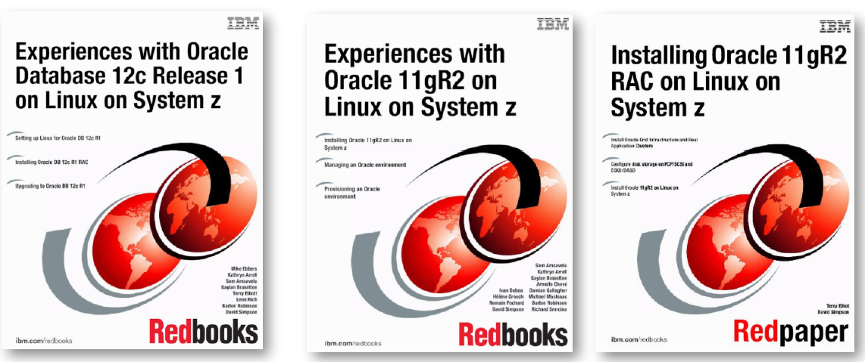
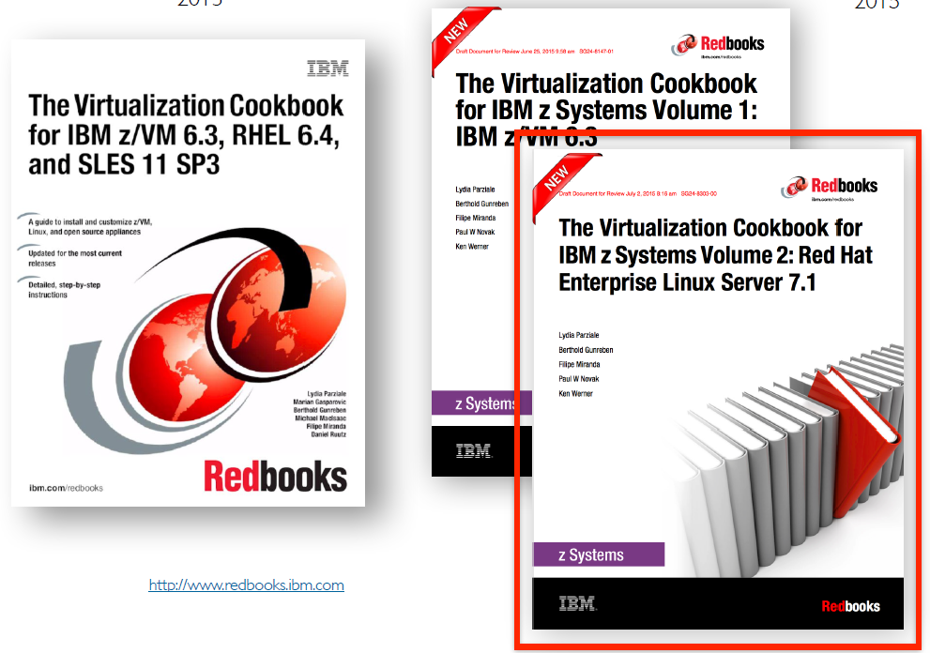
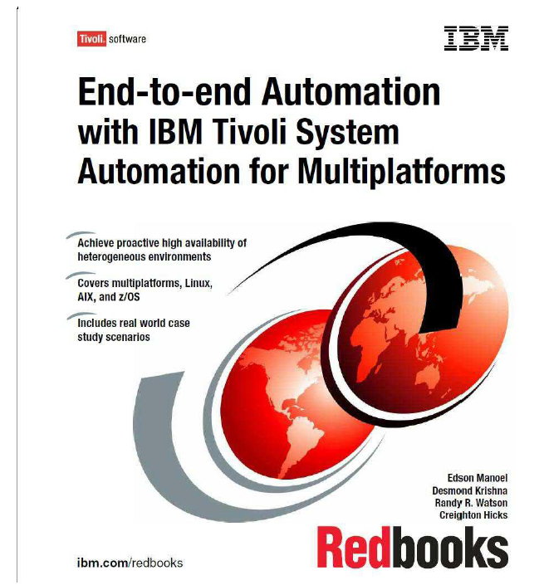
References
Source: If applicable, describe source origin

Slide 43
Thank You
Thanks for attending
Thanks to
  David Simpson
  Gaylan Braselton

