Slide 1
Linux Foundation and Open Mainframe Project Overview
Len Santalucia
CTO
Vicom Infinity, Inc
Lsantalucia@vicominfinity.com

Slide 2
Agenda
Open Source and The Linux Foundation
Open Mainframe Project Background
How to participate in the Open Mainframe Project
Q/A

Slide 3
Open Source and The Linux Foundation

Slide 4
What is Open Source?
Open source is a development method for software that harnesses the power of distributed peer review, transparency of process and the creativity of a global ecosystem of industry experts.
The promise of open source is better quality, higher reliability, more flexibility, lower cost and the opportunity to drive open standards.
Open source software is most often modular and enables open APIs that can be leveraged to swap out/in new capabilities as members of the community “scratch their own itch”.
Does not have to be just about code – open source projects often encompass marketing and infrastructure goals as well.

Slide 5

About the Linux Foundation
The Linux Foundation is hosting the Open Mainframe Project, providing operational, governance and other support
The Linux Foundation supports the Linux OS and numerous collaborative projects
> 100 staff
450+ members across all our projects
Dozens of projects beyond Linux spanning thousands of developers
Over 50 key developer events a year worldwide
Largest share of voice in open source

Slide 6
The Linux Foundation team includes
Time Magazine’s 17th most important person of the century, Winner of Millennium Technology prize, IEEE Computer Pioneer Award, Internet Hall of Fame inductee
Internationally recognized legal counsel have authored hundreds of open source legal publications, formed over 140 consortium, serve on the boards of ANSI, Center for Women in Enterprise, and more
Full time staff fluent in English, Spanish, French, German, Russian, Japanese, and Korean
Expertise in semiconductors, embedded systems, mobile computing, enterprise software, cloud infrastructure, automotive, IoT, technical training and more
Dev/Ops team that maintain and secure the world’s largest open source project with expertise in a wide variety of scalable development environments
Marketing and Ecosystem development team with experience from pre-IPO startups to large scale enterprises

Slide 7
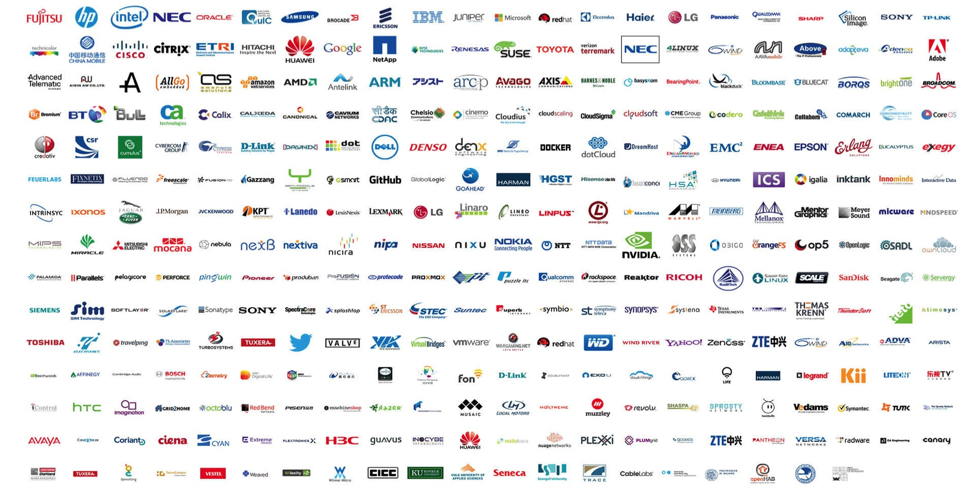
The Growing Linux Foundation Ecosystem
Notes:
Over 600 members
60+ new corporate members in 2015
13 new CPs in 2015
88 events worldwide in 2015

Slide 8





The Linux Foundation is the leader in its field.
“OpenDaylight arrives with some instant credibility because it’s hosted by the Linux Foundation, the not-for-profit that oversees the Linux operating system, the most successful open source project of them all.” -- Wired
“The mere fact that The Linux Foundation has brought together essentially all the major players in the SDN space and has gotten them to agree to work on a common, open framework is remarkable in its own right.” – Zdnet
“Just like the Linux kernel, Xen enjoys contributions from a variety of different companies, so a vendor-neutral organization to host development and collaboration is a big win for the project.” – Tech Crunch
“The Linux Foundation continues to amaze me as it never ceases to stop adding new members to its roster.” – IT Business Edge
“This organization [Bitcoin] was modeled on the Linux Foundation, according to Gavin Andresen, who is currently the Bitcoin Foundation’s chief scientist.” – The New Yorker

Slide 9
Scalable Open Source Collaboration has a Common Set of Requirements
Governance and Membership
Incorporation, Tax status, Bylaws, Member Agreements, Anti-trust, etc.
Development Process
Technical Decision Making
Infrastructure
IP Management
Custom infrastructure using open source best practices
Code Provenance
Trademark management
Legal defense and Collaboration
Security and reliability
Ongoing business development and membership recruitment
Project Life Cycle
Release Process
Ecosystem Development
Marketing
Events
Training

Slide 10
Current Linux Foundation Projects Include
Operating System
Cloud
Networking
Big Data
IoT
Web Technologies
Finance
Middleware
Security
Automotive
Mobile

Slide 11
Impact of Linux Foundation Projects
The fruit of these efforts include…
115,013,302 lines of code
As of August 2015, present in Linux Foundation’s Projects.
This would require a team of 1,356 developers 30 years to recreate.
The total economic value of this work is estimated to be more than $5 billion.

Slide 12
Open Mainframe Project Background

Slide 13





Open Source and Mainframe in 2015 and before
Disconnected, independent efforts; no shared
“hub” of innovation
Community events are industry specific, also not vendor agnostic
Open source on the mainframe lacks a neutral home for growth
No place for students
and academic
institutions to engage
Enterprise level engagement with
upstream projects limited
Notes:
Many users, many developers, many vendors but almost all are working independently or in small groups to improve open source on the mainframe. There was no open “hub” for intersecting together.
Open source software is built in a “scratch your own itch” model, but unless improvements are shared within a community, the benefits are not realized by the community.
Coordinating Enterprise Grade improvements to upstream projects is limited today and could improve the quality of improvements and ease of getting them accepted upstream.
Events, meetings and attempts to coordinate are often led by individual vendors and are often industry specific, lack a community driven purpose, organic interest or are not designed to help the collective community.
Academic institutions are looking for ways to get their students practical experience to prepare for employment with large Enterprises; clients are looking for skills to employ.
Open Source communities prosper when there is a neutral home for collaboration, built under rules that encourage participation and sharing, and are designed for the purpose of building technology that the community wants to invest collectively to build together. There are many opportunities for leveraging an open source community focused on the needs of Enterprise Grade environments.

Slide 14



Solving this through
open source
Create an
open source community to benefit Linux on the mainframe
Bring together
end-users, solution providers, app developers, and
system administrators
Provide the
neutral technical infrastructure and governance for the open source project to flourish
Notes:
Create an open source, technical community that industry and community participants may easily participate in and so that they may contribute to the creation of assets and materials that will benefit the development of Enterprise Grade characteristics of Linux such as:
High Availability and Disaster Recovery
Security
Reliability, Availability and Serviceability
Performance and Scalability
Include participation of leading members of the ecosystem, including end users, solution providers, application developers and systems administrators to ensure the Open Mainframe Project addresses the needs of the community.
Hosting the infrastructure for the open source project, establishing a neutral home for community meetings, events and collaborative discussions and providing structure around the business and technical governance of the project.

Slide 15





Why join the Open Mainframe Project?
Make mainframe
a first class
Linux platform
Collaborate with peers in a vendor neutral environment
Influence the
future direction
of mainframe
Notes:
Participate in business decisions through Board and committee representatives; leverage an ecosystem of like-minded participants to help drive your project priorities as a community.
Provide technical direction through a TSC representative (for platinum-level members) enabling fast engagement and a input into the technical direction
of the project.
Demonstrate support for the Open Mainframe Project, association with the community and help ensure the financial viability.
Priority access to any events, sponsorship and marketing opportunities.
Build a community partnered with academia to create a robust pipeline of skills.
Visibility on the Open Mainframe Project website and in membership collateral.
For academia: access to hardware labs, training resources, funding for
designated projects, and for their students access to improved
post-graduate employment options.

Slide 16

Technical Focus: Make Linux on Mainframe a first class Linux platform
Identify areas which make Linux on Mainframe adoptions problematic
Fix these problems, working as an open source community
Contribute back all work to open source communities and the upstream projects

Slide 17
Technical progress
Declared focus areas
Launch of Anomaly Detection Engine for Linux Logs project from IBM code contribution
Building Open Source Mainframe Project Database to help identify supported open source software for mainframe.
Linux Monitoring Tools

Slide 18

Academic Focus: Mainframe awareness through Linux and Open Source
Bringing Linux and Open Source education on the mainframe to academic institutions will produce the workforce of tomorrow.
Initiatives include:
  Sponsored internship program in Summer 2016
  Partnership with Linux Foundation Training to help educated facility and students on Linux and Open Source
  Partnership opportunities between Open Mainframe Project and academic institutions for real life self-study and class project programs
Notes:
Potential academic projects that the Open Mainframe Project may undertake include:
Publication of model curricula for Linux on the Mainframe courses;
Donation of fully-functional mainframe Linux environments to colleges
and universities; these environments would be staffed and maintained by students;
Specific training to prepare students to contribute to open source projects,
potentially leading to particular projects within the Open Mainframe Project
being hosted within academic institutions, with students potentially
members of the TSC;
College road shows displaying the opportunities that exist in the
Mainframe Linux industry to students and soon-to-be graduates;
Organized job-fairs;
Sponsorship (whether by the provision of funding or making key teaching
talent available) of free, on-line training courses open to all students;
Funding of a teaching chair at one or more targeted institutions; and
Organized, nation-wide (or even international) internship opportunities
for students at member academic institutions.

Slide 19

Governance Model for the Open Mainframe Project
Open Participation with corporate sponsorship opportunities
Technical Steering Committee to lead projects and oversee collaboration with upstream projects
Marketing Committee to help drive awareness in mainframe community
Governing Board oversees business decision making
19
Notes:
Anyone may participate; the Open Mainframe Project will encourage companies to become sponsoring participants and support the mission of the Open Mainframe Project with resources
Corporate participation levels include Platinum, Platinum End-User, Silver, Academic and Associate Entity levels.
A Technical Steering Committee will focus on overseeing the technical community
Approves new Open Mainframe Project projects, sets development process guidelines for the community, sets release guidelines, oversees technical collaboration with upstream projects, etc.
The initial TSC will be bootstrapped with representatives from the Platinum and Platinum End-User level participants with the goal of adding projects with Maintainers to the TSC.
Anyone can contribute, become a project committer or maintainer and thereby serve on the TSC based on the success and quality of their contributions as recognized by peers.
A Governing Board will oversee business decision making
Composed of Platinum-level participant appointees, elected Silver representatives, elected Academic Institution representatives, and the TSC Chair.
The Governing Board will address the business needs associated with budgeting, planning for any large meetings
(e.g. a Summit), marketing (if any), whether to run a “summer of code” internship, etc.

Slide 20
Technical Community Roles
TSC: top level decision making body, approves new projects and acts as an oversight committee for cross-project decisions, norms and expectations. The TSC elects a TSC Chair.
TSC and project meetings are open to anyone in the technical community, regardless of membership in the LF or the Open Mainframe Project
Projects could potentially span multiple disciplines, including code development, documentation, test/build scripting, etc.
CTO: a technical “fellow” resource who will be available to help the technical community focus, plan and execute. IBM has offered an IBM Fellow to work with the Project in this capacity.
Maintainer: lead developer on a top level project, serves on the TSC
Committer: has the ability to commit code to the project’s main branch, as a group committers elect a Maintainer
Contributor: anyone in the community that contributes code or documentation to the project, may become committers after establishing themselves
20

Slide 21
How to participate in the Open Mainframe Project

Slide 22
Participation Levels
Participation Level * | Annual Fee | Board Seat | TSC Seat | Marketing Committee | Notes
Platinum | Flat fee: $100,000 | Yes | Yes | Yes | Initial 2-year participant commitment
Platinum End-User | Flat fee: $10,000 | Yes | Yes | Yes | Initial 2-year participant commitment
Silver | $2,000 – $15,000 depending on size** | 1 per 10 | No | Yes
Academic | Free | 1 per 10 |  | Yes | Restricted to academic institutions; expected to provide environment access for the community
Associate | Free | No |  | Yes | Non-profits, open source projects
Individual | Free | No | No | No
* Anyone (including individuals, students and developers in open source project communities) may participate in the technical community work without becoming a member of the LF or Open Mainframe Project
The Open Mainframe Project is setup as a Collaborative Project under The Linux Foundation legal entity. All participants will have to be members of The Linux Foundation to participate. Please visit http://www.linuxfoundation.org/about/join/corporate to learn more about Linux Foundation membership.
    ** Silver Annual Fee Scale
    3,000 employees = $15K
    1,000 < 3,000 employees = $10K
    500 < 1,000 employees = $5K
    < 500 employees = $2K
22

Slide 23

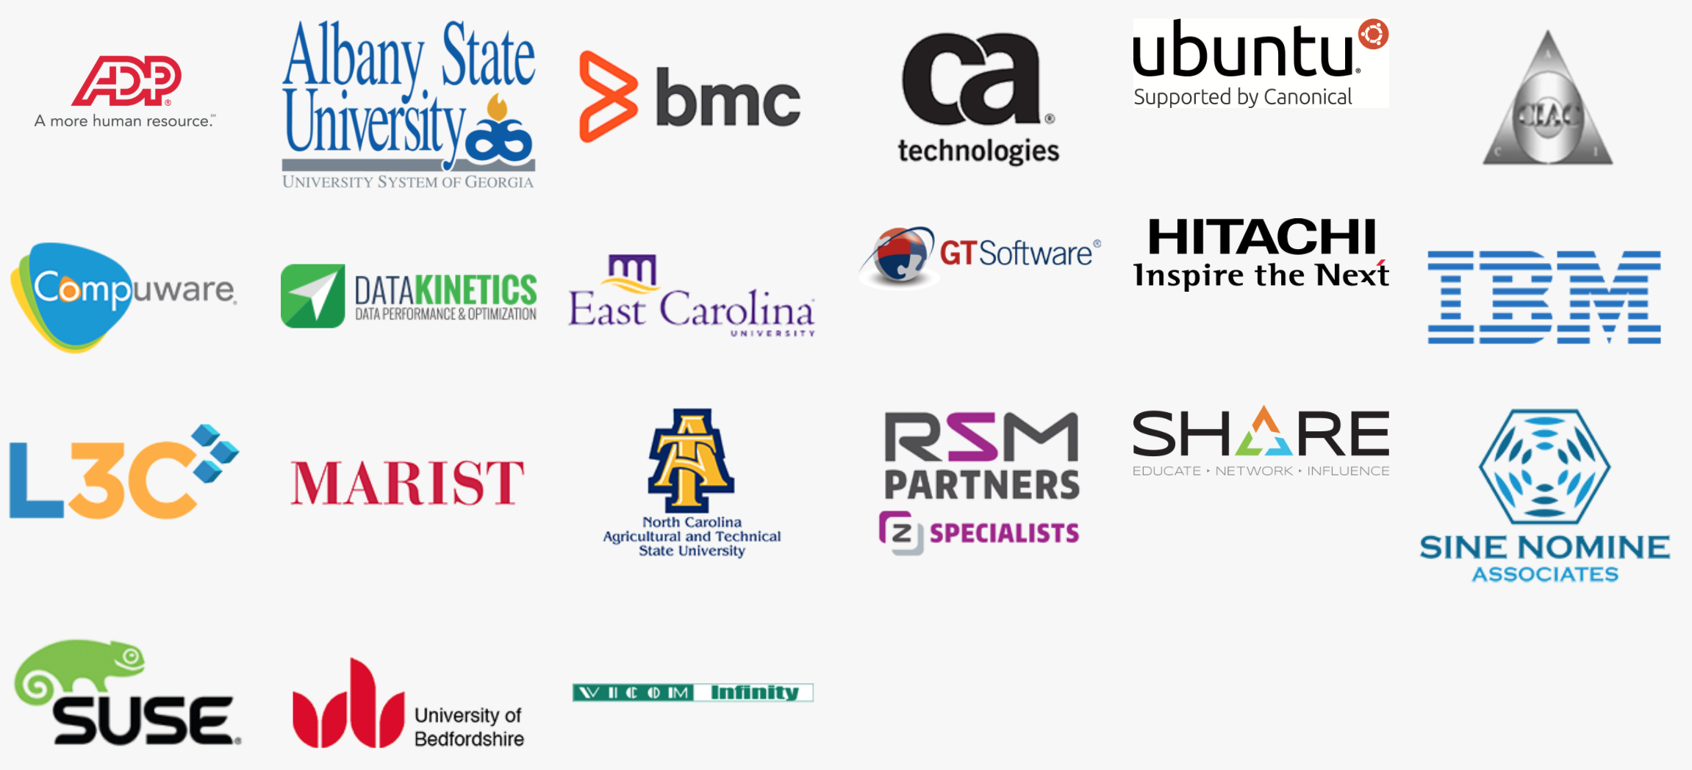
Current
Members

Slide 24

How to Join the Open Mainframe Project
Find out more the Project at www.openmainframeproject.org
Fill in the online form for more info: https://www.openmainframeproject.org/about/join
Alternatively contact John Mertic at the Linux Foundation: jmertic@linuxfoundation.org
Research other Linux Foundation Collaborative Projects:
http://collabprojects.linuxfoundation.org

Slide 25
Questions?

Slide 26
Thank you!

