Slide 1


2014
VM
Workshop
Welcome!

Slide 2
North Carolina
Agricultural & Technical
State University
SITE LOGISITICS

Slide 3
North Carolina
Agricultural & Technical
State University
Guest WiFi
    Network: aggieguest
    ID: guest
    Password: guest0103

Slide 4
North Carolina
Agricultural & Technical
State University
Parking
Hang Tags
  Purchase in “Parking Services Office” in the parking garage
Parking Garage
  $1/hr, $6 max – PER ENTRY.
  Leaving and returning restarts the clock.
SURFACE LOT
  $6/day, unlimited in/out

Slide 5
WAKEUP!
Audience Participation Calisthenics!!
•
•
•
•
•
•
•
•
•
Who traveled the FARTHEST distance?
Who had the longest trip in HOURS?
Who traveled by car pool?
Who traveled by air?
Who traveled by train?
How many paid your own expenses?
How many are being paid for by your employer?
Who’s the newest z/VM’er?
Who’s worked on VM for the longest?
•
•
•
•
•
Largest number of CECs?
Smallest CEC?
Oldest CEC?
Oldest VM release running production work?
Largest logged on ‘Linux on System z’ guest count?

Slide 6









Do you like the VM Workshop…
•
•
•
•
Low $100 registration price?
Included Thursday evening Reception and Dinner Banquet?
$65 Aggie Onecard debit cards for MEALS in the cafeteria?
Included 2014 VM Workshop polo shirt or T-shirt for students (for those registered before May 30)
and tote bag?
Then stop by the lobby Sponsor Tables to say “ Thanks!”

Slide 7
Volunteer Committee Acknowledgements
Sincere thanks to all members of the VM Workshop Volunteer Committee, who have
dedicated countless hours of personal and business time to ensure the best “up close
and personal”, and lowest cost technical education conference around.
And thanks to members who could not be present in person this year due to other
commitments! They continued to work on tasks while knowing that they would miss
out on all the fun!
Volunteer Committee members stand and introduce yourselves.
ORANGE BADGES
If you have questions about the VM Workshop, about z/VM or Linux on System z,
cold fusion, international finance, intergalactic travel, etc. - just look around for a
VM Workshop volunteer wearing an ORANGE BADGE. They have all the answers!

Slide 8
For the first time at a VM Workshop, and acknowledging NC A&T’s mainframe curriculum, we have a few students participating.
Please look for those wearing GREEN BADGES and welcome them warmly. The are the vanguard of z/VM and Linux on z/VM’s future.
They have yet begun their long careers, while some of us are nearing the end of ours, able to share provide sage advice, historical background, and hard-earned career experience – some examples…

Slide 9
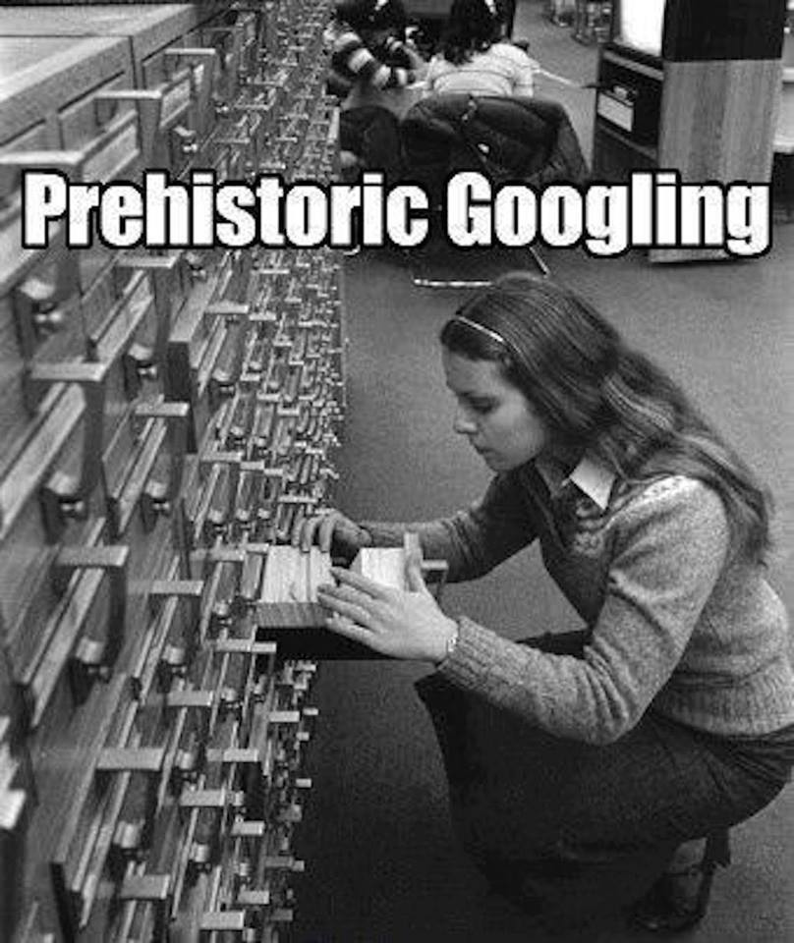

Slide 10
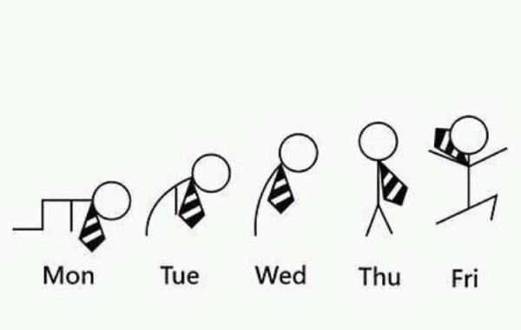
The work week’s progress in stick figures…

Slide 11


Slide 12
Speaker Acknowledgements
Sincere thanks to all the speakers at the VM Workshop, who have invested their time
preparing session materials for this workshop, and traveling here to present them.
Especially:
•
Richard Lewis of IBM, who already had a calendar so full of other activities that each
day’s entry probably requires several pages, still managed to prepare not one, but
TWO multi-hour LIVE LAB sessions! And then brought all those laptops and a couple
large boxes of lab participant materials.
•
David Boyes of Sine Nomine Associates, whose calendar wears me out just hearing
about it, who prepared a VPN tunnel appliance for non-IBM labs, and donated it to
the VM Workshop.
•
Our future speakers. Yes… YOU! We’re a very friendly audience. Please DO give
serious consideration to preparing a session to deliver yourself next year!
If you’ve never delivered a public presentation, this is a WONDERFUL PLACE to start!
Ask any speaker or Volunteer Committee member for their advice and experience.

Slide 13
What’s With the Bear?
VM’s mascot at SHARE.
Born Edgar Beargen in August 1989, after the original VM sign was missing at SCIDS.
In yet another shameful example of ‘downsizing’, SHARE’s Linux and VM program downsized Edgar’s role, replacing him with an inflatable bear!
More details (long story) on the VM Workshop web site:
(tabs: “Learn More About VM”> “Key Bits of VM and z/VM Community History”)
Some candid photos of Edgar when he was not at work at SHARE, or at the VM Workshop…

Slide 14
Why Isn’t this the “z/VM Workshop”,
or
the “‘Linux on System z’ & z/VM Workshop”?
Answer: Homage to our predecessors!
Here are pages from the previous workshops. Note that some of these meetings predate
the existence of the WWW, and thus do not have live websites. No VM Workshops were
held between 1998 and 2011.
25 2013 June 20-22 Indiana University-Purdue University , Indianapolis, Indiana
24 2012 June 27-30 University of Kentucky, Lexington, Kentucky
23 2011 July 28-30 Ohio State University, Columbus, Ohio
------------------------------------------------------------------------------------
22 1998 June 9-13 Marist College, Poughkeepsie, New York
21 1997 June 10-14 McGill University, Montréal, Québec
20 1996 June 25-29 University of Kentucky, Lexington, Kentucky
19 1995 June 14-17 Wichita State University, Wichita, Kansas
18 1994 June 7-11 University of Notre Dame, Notre Dame,
Indiana
17 1993 July 20-23 Michigan State University, East Lansing,
Michigan
16 1992 June 16-19 University of Arkansas, Fayetteville
15 1991 June 4-7 University of Kentucky, Lexington, Kentucky
14 1990 June 12-15 Indiana University-Purdue University,
Indianapolis, Indiana
13 1989 June 13-16 Kansas State University, Manhattan, Kansas
12 1988 July 19-22 Michigan State University, East Lansing, Michigan
11 1987 June 2-5 Brigham Young University, Provo, Utah
10.5 1987 Feb. 23-27 Asilomar State Park, CA
10 1986 June 3-6 University of Kentucky, Lexington, Kentucky
9 1985 June 4-7 Kansas State University, Manhattan, Kansas
8 1984 May 30-June 1 Kansas State University, Manhattan, Kansas
7 1983 June 7-10 Wichita State University, Wichita, Kansas
6 1982 June 9-11 Wichita State University, Wichita, Kansas
5 1981 June Wichita State University, Wichita, Kansas
4 1980 ?
3 1979 August Cornell University, Ithaca, New York
2 1978 August University of Maine, Orono, Maine
1 1977 University of Waterloo, Waterloo, Ontario

Slide 15
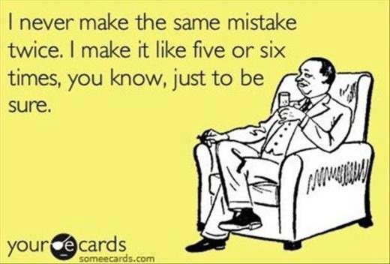

Slide 16
Back to business…
Fix the GRID…
Tonight: 18:00-21:00 - The Gala Reception and Dinner Banquet
Moved to Smith Technology Center foyer (#53 on the Campus Map)
Need to drive there, campus construction has eliminated the option to walk.
Follow the crowd.
McNeil Hall Dorm, room 6202
The VM Workshop ‘Hospitality Suite’.

Slide 17
2014 VM Workshop…
Where to next?
We will record your opinions for the 2014 VM Workshop site at the Closing Session on Saturday.
Possible locations include universities in the areas of:
George Mason University, Washington, DC
(many nearby government sites)
West Virginia
Ohio
Pittsburgh
PLEASE think about and discuss those 4 locations this week, and we’ll revisit the discussion on Saturday.
If you won’t be that the closing sessions, just write your ideas on a paper with your name and hand them to any Volunteer Committee member (ORANGE badges).

Slide 18
Speakers:
Please e-mail your session materials to: presentations@vmworkshop.org
They will be posted on the web site next week, or sooner.. “it depends” (sm) Bill Bitner
Who’s the guy with the camera (still and video)?
A: Eric Schuler-Dalverny, yet another ORANGE-badged Volunteer Committee member. And… the Chairman of the VM Workshop when this one ends.
He’s taking candid and staged still photos this week, and short videos and interviews.
With your permission, these will be edited down into a short ‘commercial’ for the VM
Workshop, and posted on our web pages, and videos on YouTube. Potential attendees
can point their management to those locations, showing that even a $100 workshop can
present amazing sessions, found to be very rewarding to attendees!

Slide 19
Comments,
suggestions,
complaints,
questions,
other?
Have
a Terrific
Learn,
Laugh,
Week:
Love
(z/VM and Linux on System z)

