Slide 1
Storage System
High-Availability & Disaster Recovery Overview [638]
John Wolfgang
Enterprise Storage Architecture & Services
jwolfgang@vicominfinity.com
26 June 2014

Slide 2
Agenda
Background
Application-Based Replication
Storage-Based Replication
  Tape Replication
  Point-in-Time Replication
  Synchronous Replication
  Asynchronous Replication
Automation
Replication Examples
Key Questions for Any Solution

Slide 3
My Background
West Virginia University
  BS Electrical Engineering
  BS Computer Engineering
Carnegie Mellon University
  MS Electrical and Computer Engineering
  Data Storage Systems Center
Lockheed Martin & Raytheon
IBM
  Development (Tucson) - Software Engineer – 10 years
  Data replication, disaster recovery, GMU, eRCMF, TPC for Replication
  Global Support Manager (New York City) – Morgan Stanley – 2 years
  IBM Master Inventor
Vicom Infinity
  Enterprise Storage Architecture and Services – 1+ years

Slide 4
Why are High Availability & Disaster Recovery Important?
Information is your most important commodity – need to protect it
What happens to your company if you don’t have access to your production data for a minute? An hour? A day? A month?
How much money does your company lose every minute?
  Amazon.com loses $66,240 per minute (Forbes.com – 8/19/2013)
  Ebay.com loses $120,000 per minute (ebay.com)

Slide 5
Lessons Learned from Previous Disasters
Rolling disasters happen
Distance is more important
Redundancy may be smoke and mirrors
If you have not successfully tested your exact DR plan, you do not have a DR plan
Automate as much as possible
  Increase dependency on automation and decrease dependency on people
  Automation provides the ability to test over and over until perfect
  Automation will not deviate from procedures
  Automation will NOT make mistakes (even under pressure!)
  Automation will not have trouble getting to the DR site
Recovery site Considerations
  Site capacity (MIPs and TBs) needs to be sized to handle the production environment
  What is the DR Plan after successful recovery from disaster
  Disasters may cause multiple companies to recover and that puts stress on the commercial business recovery services

Slide 6
Replication Beyond Disaster Recovery
Disaster Recovery/
Business Continuity
Minimize data loss
Minimize restart time
Increase distance
Enable automation
Availability
Improvements
Backup Window
Tape Backup
Data Migration
Archival
Operational
Efficiency
Data Mining
Content Distribution
Software Testing

Slide 7
Some Definitions
Recovery Point Objective (RPO)
  How much data can you tolerate losing during a disaster
Recovery Time Objective (RTO)
  How much time will it take to get your systems up and running again after a disaster
Replication Method
Point-in-Time
Continuous
App-Based
Storage-Based
Synchronous
Asynchronous
App-Based
Storage-Based
App-Based
Storage-Based

Slide 8
7 Tiers of Business Recovery Options
Key Customer Objectives:
RTO – Recovery Time Objective
RPO – Recovery Point Objective
Mission Critical Data
1000
700
400
100
50
10
1
Tier 7 - RPO=Near Zero, RTO <1Hr. Server/Workload/Network/Data Automatic Site Switch
Tier 6 - RPO=Near Zero, RTO= Manual - Disk or Tape Data Mirroring
Tier 5 - RPO > 15 min. RTO= Manual; PiT or
SW Data Replication
Cost of Ownership
(Servers/Network Bandwidth/Storage)
Active Secondary Site
Tier 4 - Data Base Log Replication &
Host Log Apply at Remote
RPO: 4+ hrs
RTO: 4+ hrs
Tier 3 – Electronic Tape Vaulting
Tier 2 – PTAM & Hot Site
Point-in-time Backup to Tape
RPO: 24+ hrs
RTO: Days
Tier 1 – PTAM*
15 Min.
1-4 Hr.
4 -8 Hr.
8-12 Hr..
12-16 Hr..
24 Hr..
Days
Less Critical Data
Time to Recover – How quickly is an application recovered after a disaster?
*PTAM – Pickup Truck Access Method

Slide 9
Agenda
Background
Application-Based Replication
Storage-Based Replication
  Tape Replication
  Point-in-Time Replication
  Synchronous Replication
  Asynchronous Replication
Automation
Replication Examples
Key Questions for Any Solution

Slide 10
Application-Based vs. Storage-Based Replication (1)
Application/File/Transaction Based
Specific to application/file system/database
Generally less data is transferred
  Lower telecommunication costs
No coordination across applications, FSs, DBs, etc.
Applications change - replication may need to change
May forget “other" related data necessary for recovery
With many transfers occurring in a corporation, it may be difficult to determine what is where in a disaster. RTO/RPO may not be repeatable, auditing may be difficult
Many targets possible (ex. millions of cell phones)
Notes:
if you have specific application things - sending over the exact # of bytes changed. Extremely dependent on that specific application. system things, cross-appl things are not included.
Post office looking into realtime mirroring between MN and CA - line cost $1 million/month. so used DB2 replicator to reduce cost.
Lotus notes replication down to thinkpad everyday - ONLY lotus notes
IBM Academy meeting on Data replication - notes people were looking at common SW replication to multiple targets.

Slide 11
Application-Based Replication Examples
DB2 HADR
High availability solution for both partial and complete site failures
Log data is shipped and applied to standby database
  One or more standby databases
If primary database fails, applications are redirected to the standby database
Standby database takes over in seconds
  Avoids database restart upon a partial error
LVM Mirroring
Create more than one copy of a physical partition to increase data availability
Handled at the logical volume level
If a disk fails, can still have access the data on an alternate disk
Remote LVM mirroring enables use of disks located at multiple locations
  Replication between multiple storage systems via a Storage Area Network (SAN)

Slide 12
Agenda
Background
Application-Based Replication
Storage-Based Replication
  Tape Replication
  Point-in-Time Replication
  Synchronous Replication
  Asynchronous Replication
Automation
Replication Examples
Key Questions for Any Solution

Slide 13
Application-Based vs. Storage-Based Replication (2)
Storage-Based – Block Level Replication
Independent of application, file systems, databases, etc.
Common technique for corporation
  Managed by operations
Generally more data transferred
  Higher telecommunication costs
Consistency groups yield cross volume/storage subsystem data integrity/consistency
Independent of application changes.
  Mirror all pools of storage
Consistent repeatable RPO.
RTO depends on server/data/workload/network
Generally a handful of targets
Specific to data replication technique (tied to specific architecture & devices that support it)
Notes:
We are talking about mirroring physical block or record
Independent of actual data
Copy fliesystem, DBs, systems data - all with same technique
Tend to send more data
How to provide consistency at remote site?
If some links break, how do i make sur eits consistent
Application understands the consistency of the data, block based do not

Slide 14
What Does Data Consistency Really Mean?
For storage-based replication, we are talking about “power fail” consistency
Typical Database transaction:
  Update log – database update is about to occur
  Update database
  Update log - database update complete
Host is very careful to do each of the transactions in order
  This provides power fail data consistency
BUT, these transactions are likely done to different volumes possibly on different control units
Failure to be careful about transaction order results in loss of data consistency and data may become unusable
In order to ensure data consistency at secondary site, dependent writes must be done in order
How does a storage system know which writes are dependent?
  It doesn’t
  What it does know is that writes that are done in parallel are not dependent
  Any writes NOT done in parallel are assumed to be dependent
This is exacerbated for asynchronous replication
LOG-1,3
DB-2

Slide 15
Storage-Based Replication Techniques
Tape
Pickup Truck Access Method (PTAM)
Virtual Tape Replication
Disk
Point-in-Time Copy
Synchronous Replication
Asynchronous Replication
Three-site Replication (Synchronous & Asynchronous)
Automation
Hyperswap
Tivoli Storage Productivity Center for Replication
Globally Dispersed Parallel Sysplex (GDPS)

Slide 16
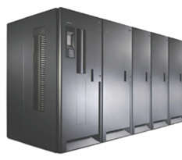
Tape Replication - PTAM
Backups created and dumped to physical tapes
  Recovery Point Objectives quite high – 24 hours at best?
Tapes are literally picked up by a truck and taken to another location
  Hot site
  Storage only
  Recovery Time Objective fairly high in both cases
Lower cost and simpler option than disk replication

Slide 17
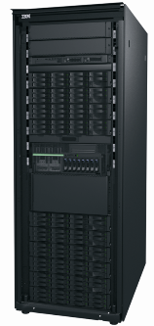
Tape Replication – Virtual Tape Grid
Virtual Tape Servers appear to hosts as standard tape volumes
  May or may not actually contain tape drives and tapes
Multiple clusters can be put together into a tape grid
Tape volumes can be selectively replicated to one or more other clusters
Tape volumes can be accessed through any cluster in the grid
  Whether or not the tape volume physically resides on that cluster
Certain virtual tape server models have physical tape libraries behind them that can offload volumes to actual tapes
Hybrid with characteristics of both tape backup and replication
  Recovery Point Objective much better than PTAM
Cluster 1
TS7740
Cluster 0
TS7720
WAN
TS3500
Cluster 3
TS7720

Slide 18
7 Tiers of Business Recovery Options
Key Customer Objectives:
RTO – Recovery Time Objective
RPO – Recovery Point Objective
Mission Critical Data
1000
700
400
100
50
10
1
Tier 7 - RPO=Near Zero, RTO <1Hr. Server/Workload/Network/Data Automatic Site Switch
Tier 6 - RPO=Near Zero, RTO= Manual - Disk or Tape Data Mirroring
Tier 5 - RPO > 15 min. RTO= Manual; PiT or
SW Data Replication
Cost of Ownership
(Servers/Network Bandwidth/Storage)
Active Secondary Site
Tier 4 - Data Base Log Replication &
Host Log Apply at Remote
RPO: 4+ hrs
RTO: 4+ hrs
Tier 3 – Electronic Tape Vaulting
Tier 2 – PTAM & Hot Site
Point-in-time Backup to Tape
RPO: 24+ hrs
RTO: Days
Tier 1 – PTAM*
15 Min.
1-4 Hr.
4 -8 Hr.
8-12 Hr..
12-16 Hr..
24 Hr..
Days
Less Critical Data
Time to Recover – How quickly is an application recovered after a disaster?
*PTAM – Pickup Truck Access Method

Slide 19
Point-in-Time vs. Continuous Replication
Point-in-Time
  Local copy of data
  Data “Frozen”
  Provides protection against logical corruption, user error
  Data is not the most current
Continuous Replication
  Remote copy of the data
  Provides protection against primary storage system or data center issue
  Continuously updated
  Data is always current (or close to it)
  Corruption/Errors on the primary site will be transferred to the secondary

Slide 20
Point-in-Time Copy
Internal to Storage System
New copy created and available immediately
Possible to read & write to both volumes
No-Copy
  No data is copied to Target unless updated on the Source
Copy on Write
  Data must be copied to Target before being updated on Source
Background Copy
  All data from Source copied to Target
  Relationship typically ends when copy is complete
Incremental Copy
  Full background copy is done the first time
  Only changes copied subsequently
Space Efficient/Thin Provisioned
  Only allocate space as it is used
Write to source
Storage System
Source
Target

Slide 21
7 Tiers of Business Recovery Options
Key Customer Objectives:
RTO – Recovery Time Objective
RPO – Recovery Point Objective
Mission Critical Data
1000
700
400
100
50
10
1
Tier 7 - RPO=Near Zero, RTO <1Hr. Server/Workload/Network/Data Automatic Site Switch
Tier 6 - RPO=Near Zero, RTO= Manual - Disk or Tape Data Mirroring
Tier 5 - RPO > 15 min. RTO= Manual; PiT or
SW Data Replication
Cost of Ownership
(Servers/Network Bandwidth/Storage)
Active Secondary Site
Tier 4 - Data Base Log Replication &
Host Log Apply at Remote
RPO: 4+ hrs
RTO: 4+ hrs
Tier 3 – Electronic Tape Vaulting
Tier 2 – PTAM & Hot Site
Point-in-time Backup to Tape
RPO: 24+ hrs
RTO: Days
Tier 1 – PTAM*
15 Min.
1-4 Hr.
4 -8 Hr.
8-12 Hr..
12-16 Hr..
24 Hr..
Days
Less Critical Data
Time to Recover – How quickly is an application recovered after a disaster?
*PTAM – Pickup Truck Access Method

Slide 22
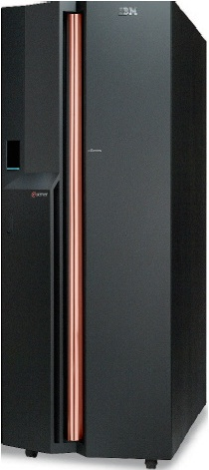
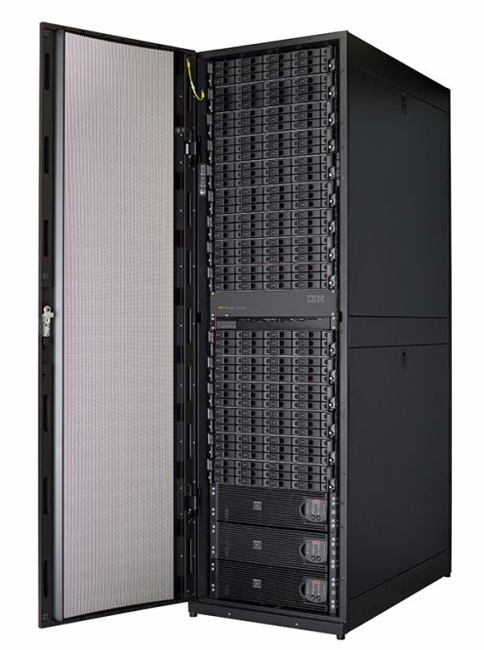
Synchronous Replication Overview
Server Write
Write Acknowledge
Write to Secondary
Write Acknowledged to Primary
Primary
Secondary

Slide 23
Synchronous Replication
Data on secondary storage system is always identical to primary
  Recovery Point Objective of 0
Standard implementation for many storage vendors
There is an impact on application I/Os
  Dependent on distance between primary and secondary
  Distance to 300 km
  Bandwidth must be sufficient for peak
Data Freeze technology keeps all pairs in consistency group consistent
  Requires automation to guarantee consistency across multiple storage systems
Primary
Storage
System
Secondary
Storage
System
Synchronous
Replication
H1
H2

Slide 24
Practice How you Recover and Recover How you Practice
Proper Disaster Recovery Tests require time & effort & commitment
If you haven’t successfully tested your exact DR plan, you don’t have a DR plan
A DR test may require you to stop data replication temporarily
Use Practice Volumes to test properly while continuing replication
Practice Volumes can also be used for other activities
  Development, testing, data analytics
Make sure you always recover to the Practice Volumes – even in a real disaster

Slide 25
Synchronous Replication with Practice Volumes
Standard synchronous replication as the basis
Typical synchronous replication requires replication outage for DR testing
Practice volumes provide capability to continue replication during DR testing
Data is recovered to secondary storage system
Point-in-Time copy created on secondary storage system
Replication is restarted while access to H2 volume still available
Should recover in actual disaster using the same method
Primary
Storage
System
Secondary
Storage System
Synchronous
Replication
PIT Copy for
DR Testing
H1
I2
H2

Slide 26

Asynchronous Replication Overview
Server Write
Write Acknowledge
Write to Secondary
Write Acknowledged to Primary
Primary
Secondary

Slide 27
Asynchronous Replication – No Consistency
Asynchronous transfer of data updates
No distance limitation
Little impact on application I/Os
Secondary not guaranteed consistent
  No write ordering
  No consistent data sets
  Hosts/Applications must be shut down to provide consistency
Most useful for migration
Can transition to/from Synchronous replication
Primary
Storage System
Secondary Storage
System
Asynchronous
Replication
H1
H2

Slide 28
Asynchronous Replication – Two Volumes
Asynchronous transfer of data updates
  Recovery Point Objective > 0
No distance limitation
Little impact on application I/Os
Data consistency maintained via:
  Write ordering
  Consistent data sets
If bandwidth is not sufficient for peak, data will back up on the primary
  Some vendors require extra cache
Primary
Storage System
Secondary Storage
System
Asynchronous
Replication
H1
H2

Slide 29
Asynchronous Replication – Three Volumes
Asynchronous transfer of data updates
    Recovery Point Objective > 0
No distance limitation
Little impact on application I/Os
Data consistency created using 3rd volume
Consistency coordinated by primary storage system
If bandwidth is not sufficient for peak, RPO will grow and “catch up” later
Primary Storage System
Secondary
Storage System
Asynchronous
Replication
PIT Copy
H1
H2
J2

Slide 30
Asynchronous Replication With Practice Volumes
Standard asynchronous replication as the basis
  Could be any of the consistent variants
Typical asynchronous replication requires replication outage for DR testing
Practice volumes provide capability to continue replication during DR testing
Data is recovered to secondary storage system in typical manner
Point-in-Time copy created on secondary storage system
Replication is restarted while access to H2 volume still available
Should recover in actual disaster using the same method
Primary Storage System
Secondary
Storage System
Asynchronous
Replication
PIT Copy
H1
I2
J2
H2

Slide 31
Asynchronous Replication – z/OS Interaction
Asynchronous transfer of data updates
    Recovery Point Objective > 0 but very low (~seconds)
No distance limitation
Little impact on application I/Os
Managed by System z
Multiple Storage vendors
Source
z Host
Target
z Host
Write Acknowledge
Server Write
Asynchronous
Replication
Controlled by SDM on
Target System z Host
Primary Storage System
Secondary
Storage System
H1
H2

Slide 32
Asynchronous Replication – Four Volumes/PiT Copies
Asynchronous transfer of data updates
    Recovery Point Objective typically higher than previously discussed implementations
    RPO is 2x the “cycling period”
    Can tolerate lower network bandwidth
Little impact on application I/Os
Periodic consistent PiT copies are created from primary volumes
PiT copies are replicated to secondary volumes
  Does not require a consistent replication mechanism
After copy is complete, PiT copies are created from secondary volumes for protection
Primary
Storage System
Secondary
Storage System
Asynchronous
Replication
H1
H2
PiT
Copy
PiT
Copy
C1
C2

Slide 33
Three-Site Replication - Cascading
Combination of Synchronous & Asynchronous replication techniques
Synchronous replication to provide High Availability at metro distances
  Protect against storage system & data center disasters
Asynchronous replication to provide disaster recovery capability at global distances
  Protect against regional disasters
Ability to switch production between primary and secondary systems
Incremental resynchronization between primary and tertiary if secondary lost
Requires automation to handle the various transitions
Synchronous Replication
Primary Storage System
Secondary Storage System
Tertiary
Storage System
PiT Copy
H1
H2
H3
J3
Asynchronous Replication

Slide 34
Three-Site Replication – Multi-Target
Combination of Synchronous & Asynchronous replication techniques
Synchronous replication to provide High Availability at metro distances
  Protect against storage system & data center disasters
Asynchronous replication to provide disaster recovery capability at global distances
  Protect against regional disasters
Synchronous Replication
Secondary
Storage System
Primary Storage System
Tertiary
Storage System
H2
H1
H3
Asynchronous Replication

Slide 35
Agenda
Background
Application-Based Replication
Storage-Based Replication
  Tape Replication
  Point-in-Time Replication
  Synchronous Replication
  Asynchronous Replication
Automation
Replication Examples
Key Questions for Any Solution

Slide 36
7 Tiers of Business Recovery Options
Key Customer Objectives:
RTO – Recovery Time Objective
RPO – Recovery Point Objective
Mission Critical Data
1000
700
400
100
50
10
1
Tier 7 - RPO=Near Zero, RTO <1Hr. Server/Workload/Network/Data Automatic Site Switch
Tier 6 - RPO=Near Zero, RTO= Manual - Disk or Tape Data Mirroring
Tier 5 - RPO > 15 min. RTO= Manual; PiT or
SW Data Replication
Cost of Ownership
(Servers/Network Bandwidth/Storage)
Active Secondary Site
Tier 4 - Data Base Log Replication &
Host Log Apply at Remote
RPO: 4+ hrs
RTO: 4+ hrs
Tier 3 – Electronic Tape Vaulting
Tier 2 – PTAM & Hot Site
Point-in-time Backup to Tape
RPO: 24+ hrs
RTO: Days
Tier 1 – PTAM*
15 Min.
1-4 Hr.
4 -8 Hr.
8-12 Hr..
12-16 Hr..
24 Hr..
Days
Less Critical Data
Time to Recover – How quickly is an application recovered after a disaster?
*PTAM – Pickup Truck Access Method

Slide 37
High Availability
Hyperswap for Synchronous Replication Configurations
Triggered when there is a problem writing or accessing the primary storage devices
Swap from using primary storage devices to secondary storage devices
Transparent to applications (brief pause on the order of seconds)
Steps
  Physically switch the secondary storage devices to be primary and allow access
  Logically switch the OS internal pointers in the UCBs
  Applications are not aware that they are now using the secondary devices
No Shutdown, No Configuration Changes, No IPL
Managed by Automation software (GDPS, TPC for Replication)
Planned Hyperswap
  Use for maintenance, production site move, migration
Unplanned Hyperswap
  Automated to protect against storage system failure

Slide 38
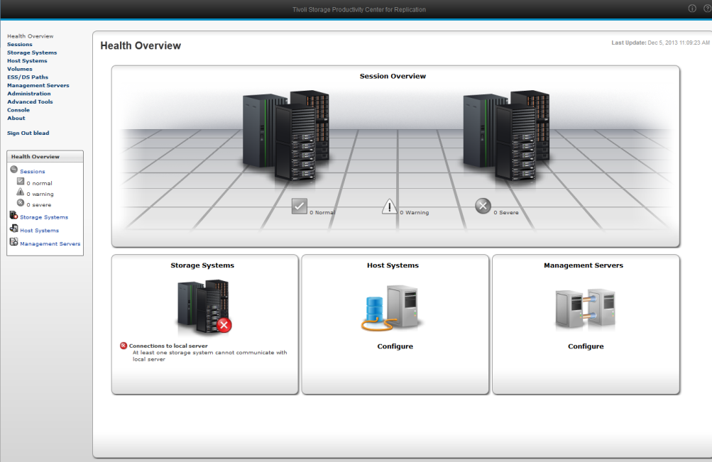
Tivoli Storage Productivity Center for Replication
Automate and simplify complex data replication tasks
Control multiple replication types and storage systems from a single pane
  Including CKD and FB volumes
Added Error Protection
Added Ease of Use
Facilitates DR Testing and DR Recovery
Enables Basic Hyperswap, Hyperswap, Open Hyperswap
GUI-based
  Operational control of replication
  environment via a GUI rather
  than DSCLI scripts or TSO commands
    Also provides a CLI
Linux, Windows, AIX, z/OS

Slide 39
Globally Dispersed Parallel Sysplex (GDPS)
Enables Business Recovery Tier 7 capability
Manage all forms of replication
Manage Hyperswap
Drive down RTO through automation
Scripting Capability provides ability to automate the recovery process at the DR site
  Enable CBU
  Automate Recovery of Disk systems
  Automate IPL of LPARs
  Automate application startup

Slide 40
7 Tiers of Business Recovery Options
Key Customer Objectives:
RTO – Recovery Time Objective
RPO – Recovery Point Objective
Mission Critical Data
1000
700
400
100
50
10
1
Tier 7 - RPO=Near Zero, RTO <1Hr. Server/Workload/Network/Data Automatic Site Switch
Tier 6 - RPO=Near Zero, RTO= Manual - Disk or Tape Data Mirroring
Tier 5 - RPO > 15 min. RTO= Manual; PiT or
SW Data Replication
Cost of Ownership
(Servers/Network Bandwidth/Storage)
Active Secondary Site
Tier 4 - Data Base Log Replication &
Host Log Apply at Remote
RPO: 4+ hrs
RTO: 4+ hrs
Tier 3 – Electronic Tape Vaulting
Tier 2 – PTAM & Hot Site
Point-in-time Backup to Tape
RPO: 24+ hrs
RTO: Days
Tier 1 – PTAM*
15 Min.
1-4 Hr.
4 -8 Hr.
8-12 Hr..
12-16 Hr..
24 Hr..
Days
Less Critical Data
Time to Recover – How quickly is an application recovered after a disaster?
*PTAM – Pickup Truck Access Method

Slide 41
Data Replication Considerations
Synchronous solutions do not work at distance
Asynchronous solutions have data loss and potential problems managing consistency, particularly across different storage platforms
Maximizing use of long distance link is critical for many customers
  Smaller customers may want to purchase extended links which meet maximum transfer requirements for a shift, not their 15 second peak
Being able to test, recover data at the recovery site, and replicate back to the production site after resolution is critical
  If you have not successfully tested your DR procedures, you do NOT have DR procedures
  Practice how you recover, and recover how you practice

Slide 42
Agenda
Background
Application-Based Replication
Storage-Based Replication
  Tape Replication
  Point-in-Time Replication
  Synchronous Replication
  Asynchronous Replication
Automation
Replication Examples
Key Questions for Any Solution

Slide 43
Fit For Purpose – Two & Three Site Replication
Tailor your solution to your needs (and budget)
Synchronous replication for everything
Three-site Synchronous/Asynchronous only for your most important data
Source Host
Synchronous
Asynchronous
Primary Storage System
Secondary
Storage System
H1
H2
Tertiary
Storage System
PiT Copy
H1
H2
H3
J3

Slide 44
Fit For Purpose – Asynchronous Replication
Save money and reduce complexity by replicating some data consistently and other data with no consistency
Make sure you understand the ramifications of these decisions
Source Host
Primary Storage System
No Consistency
Secondary
Storage System
H1
H2
PiT Copy
H1
H2
J3
Consistent
Asynchronous

Slide 45
Low Cost Asynchronous with Consistency
Create periodic consistent PiT copies of primary production volumes
Use asynchronous replication with no consistency to copy all data to secondary
When all the data is copied, the secondary volumes are consistent
Lower network bandwidth requirements
Avoids extra volume at secondary site
Use Space Efficient PiT copy to conserve even more space
Useful for testing, data analytics, or high RPO requirements
Source Host
Primary
Storage System
Secondary Storage
System
H1
Asynchronous
Replication
PiT
Copy
T1
H2

Slide 46
Four Site Replication
Synchronous replication to provide high-availability
Asynchronous cascaded replication to provide global distance DR capability
Cascaded asynchronous leg to provide another copy of data
  Used for development, testing, data analytics
  Only consistent periodically
Synchronous
Asynchronous
Primary Storage System
Secondary
Storage System
Tertiary
Storage System
H1
H2
H3
J3
PiT Copy
Asynchronous – No Consistency
Quaternary(?) Storage System
H4
Source Host

Slide 47
PIT Copies for Tape Backup
Create periodic PiT copies of primary production volumes
Dump these PiT copies to tape for backups
Avoids the tape backup software accessing production volumes
Use minimum space by employing Space Efficient PiT copies
Source Host
Tape System
Primary
Storage System
H1
PiT
Copy
T1

Slide 48
Key Questions for Any Potential Solution
How does the solution provide cross volume/cross subsystem data integrity/data consistency ?
What is the impact to the primary application I/O ?
What happens if data replication fails or slows down ?
Interoperability with other data replication solutions ?
Cost of installing & maintaining solution?
Do solutions provide “concurrent maintenance” ?
What flexibility does the solution provide ?
If I recover to the secondary site, how do I replicate back to the primary?
If I use different “types" of disk subsystems, after recovery can I maintain my QoS to my users?

Slide 49
Questions?
Thank you!
John Wolfgang
Enterprise Storage Architecture & Services
jwolfgang@vicominfinity.com
26 June 2014

Slide 50
About Vicom Infinity
For More Information please contact…
Len Santalucia, CTO & Business Development Manager
Vicom Infinity, Inc.
One Penn Plaza – Suite 2010
New York, NY 10119
212-799-9375 office
917-856-4493 mobile
lsantalucia@vicominfinity.com
About Vicom Infinity
Account Presence Since Late 1990’s
IBM Premier Business Partner
Reseller of IBM Hardware, Software, and Maintenance
Vendor Source for the Last 8 Generations of Mainframes/IBM Storage
Professional and IT Architectural Services
Vicom Family of Companies Also Offer Leasing & Financing, Computer Services, and IT Staffing & IT Project Management

