Slide 1



2014
VM
Workshop
Thank
you!

Slide 2
Dorm Room checkout
•
Check-out time: 1-5 PM
Return to dorm registration check-in/out desk…
  Room/closet keys - in brown envelope they came in (if you have it)
  Bedding
  Remove trash from room
Aggie Onecards
  Keep them as a souvenir if you wish, or …
  discard them at home (they are active until 7PM)
  We only pay for what was used

Slide 3









A final THANKS to all our sponsors,
without whom this VM Workshop
would not be possible!
Please stand to be acknowledged.

Slide 4
Speaker Acknowledgements
Sincere thanks to all the speakers at the VM Workshop, who have invested their time
preparing session materials for this workshop, and traveling here to present them.
Especially:
•
Richard Lewis of IBM, who already had a calendar so full of other activities that each
day’s entry probably requires several pages, still managed to prepare not one, but
TWO multi-hour LIVE LAB sessions! And then brought all those laptops and a couple
large boxes of lab participant materials.
•
Our future speakers. Yes… YOU! We’re a very friendly audience. Please DO give
serious consideration to preparing a session to deliver yourself next year!
Speakers please stand to be acknowledged
Speakers:
Please e-mail your session materials to: presentations@vmworkshop.org
They will be posted on the web site next week, or sooner.. “it depends” (sm) Bill Bitner

Slide 5
Volunteer Committee Acknowledgements
Sincere thanks to all members of the VM Workshop Volunteer Committee, who have
dedicated countless hours of personal and business time to ensure the best “up close
and personal”, and lowest possible cost, technical education conference around.
The VM Workshop is now the largest conference world-wide focused exclusively on z/VM and ‘Linux on System z’!!
And thanks to members who could not be present in person this year due to other
commitments! They continued to work on tasks while knowing that they would miss
out on all the fun!
Volunteer Committee members stand and be acknowledged!
And a special recognition of
VM Workshop Chairman 2015/2016 …
Eric Schuler-Dalverny
Volunteers, please stand to be acknowledged.

Slide 6
Why Isn’t this the “z/VM Workshop”,
or
the “‘Linux on System z’ & z/VM Workshop”?
Answer: Homage to our predecessors!
Here are pages from the previous workshops. Note that some of these meetings predate
the existence of the WWW, and thus do not have live websites. No VM Workshops were
held between 1998 and 2011.
26 2014 June 26-28 North Carolina A&T State University
25 2013 June 20-22 Indiana University-Purdue University , Indianapolis, Indiana
24 2012 June 27-30 University of Kentucky, Lexington, Kentucky
23 2011 July 28-30 Ohio State University, Columbus, Ohio
------------------------------------------------------------------------------------
22 1998 June 9-13 Marist College, Poughkeepsie, New York
21 1997 June 10-14 McGill University, Montréal, Québec
20 1996 June 25-29 University of Kentucky, Lexington, Kentucky
19 1995 June 14-17 Wichita State University, Wichita, Kansas
18 1994 June 7-11 University of Notre Dame, Notre Dame,
Indiana
17 1993 July 20-23 Michigan State University, East Lansing,
Michigan
16 1992 June 16-19 University of Arkansas, Fayetteville
15 1991 June 4-7 University of Kentucky, Lexington, Kentucky
14 1990 June 12-15 Indiana University-Purdue University,
Indianapolis, Indiana
13 1989 June 13-16 Kansas State University, Manhattan, Kansas
12 1988 July 19-22 Michigan State University, East Lansing, Michigan
11 1987 June 2-5 Brigham Young University, Provo, Utah
10.5 1987 Feb. 23-27 Asilomar State Park, CA
10 1986 June 3-6 University of Kentucky, Lexington, Kentucky
9 1985 June 4-7 Kansas State University, Manhattan, Kansas
8 1984 May 30-June 1 Kansas State University, Manhattan, Kansas
7 1983 June 7-10 Wichita State University, Wichita, Kansas
6 1982 June 9-11 Wichita State University, Wichita, Kansas
5 1981 June Wichita State University, Wichita, Kansas
4 1980 ?
3 1979 August Cornell University, Ithaca, New York
2 1978 August University of Maine, Orono, Maine
1 1977 University of Waterloo, Waterloo, Ontario

Slide 7
2015 VM Workshop…
Where to next?
We will record your opinions for the 2015 VM Workshop site now.
Possible locations include universities in the areas of:
George Mason University, Washington, DC
(many nearby government sites)
West Virginia
Ohio
Pittsburgh
You may also vote online from the link: 2015 Workshop location Site Survey
on the VM Workshop 2014 home page.

Slide 8
Comments,
suggestions,
complaints,
questions,
other?
Hope you had a Terrific
Learned,
Laughed,
Week:
Loved (z/VM and Linux on System z)

Slide 9



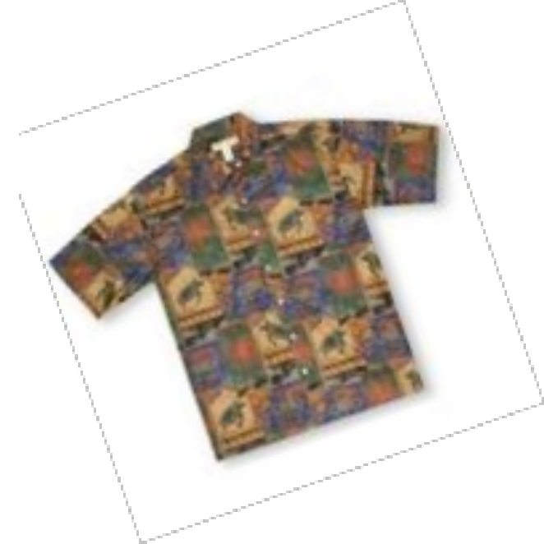

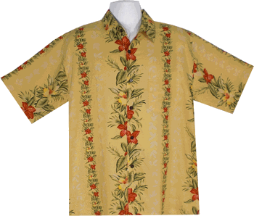
So what’s really ugly?
Ugly
Hawaiian
Shirt
Contest

Slide 10
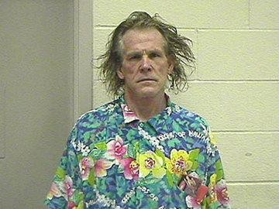
Ugly
Hawaiian
Shirt
Contest

Slide 11
Dorm Room checkout
Check-out time: 1-5 PM
Return to dorm registration check-in/out desk…
  Room/closet keys - in brown envelope they came in (if you have it)
  Bedding
  Remove trash from room
Aggie Onecards
  Keep them as a souvenir if you wish, or …
  discard them at home (they are active until 7PM)
  We only pay for what was used
  Have a safe trip home!

