Slide 1
IPV6 Evolution is coming. Are we Ready?

Slide 2
Table of Contents
Business Drivers / Why Now
Technology Drivers
How all of this affects our business and our customers
Frequently Asked Questions Appendix

Slide 3
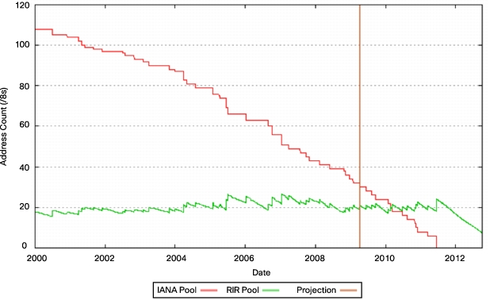
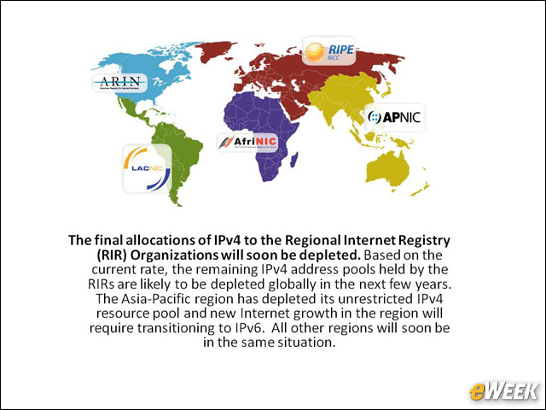
Business Drivers – Why Now IPv4 Addresses Have Run Out
IPv4 Address Space is Exhausted

Slide 4
Business Drivers – Why Now
All Federal agencies are mandated by the Office of Management and Budget (OMB) to be IPV6 capable by 2014
Some customers are already prepping for IPV6
Just a matter of time before a customer mandates that we are IPv6 capable.
Better to be proactive than reactive.
IPv6’s presence is akin to expanding wave increasing in speed and potential, akin to a tsunami.

Slide 5

Its Coming

Slide 6
Technology Drivers
Internet Assigned Numbers Authority(IANA) control Internet address allocations globally
IANA no longer has IPV4 addresses.
There will be organizations attempting to reach your mail, web, application servers via IPv6
The biggest and first impact is with Internet access.
Asia-Pacific and North American regions have a very limited IPv4 resource pool and new Internet growth in the region will require transitioning to IPv6.
Asia has matured vs. the United States in IPv6 deployment. In order to gain Asian business, it would be wise to have an IPV6 footprint

Slide 7
Frequently asked Questions Q1: What is the urgency of our organization to be compliant vs complacent to IPV6?
Answer: The urgency has to do with how soon do we think we may have to deal with the reality keeping in mind that it will take time to evolve into IPv6.
EG: Federal Agencies have mandates for 2012 and 2014 but they will likely need to be dual-stack(IPV4/IPV6) for many years to come.

Slide 8
Frequently asked Questions Q2: What is IPv6
Answer: IPv6 is the future
IPv6 quadruples the bits in the network address from 32 (in IPv4) to 128
That translates to roughly 10^18 addressable entities!
Provides more than enough globally unique IP addresses for every networked device on the planet (trillions).
Notes:
See my question in parentheses
I still think you should repeat “Frequently Asked Questions” on each question slide

Slide 9
Frequently asked Questions Q2: What is IPv6 (cont) ?
Internet Engineering Task Force(IETF) creates RFCs for TCP/IP
No alternative to IPv6
All network equipment must be in compliance w/RFC’s
Some apps coming out in IPv6 transport only

Slide 10
Frequently asked Questions Q3: What happens if Signon from IPv6 customer?
Answer:
If our organization is not prepared the Signon will fail And we lose business.
The likelihood is quite high that we will soon interact with an IPv6-ONLY customer
Presumably we would want our critical applications to be accessible to all our clients.

Slide 11
Frequently asked Questions Q4: Will Our Organization Need IPv6?
Answers:
“You don’t want to be the only company that offers fax instead of email.”
John Curran (CEO ARIN)
Do you want to be thought of as a technology leader or someone who has to be dragged reluctantly into the future?
The proliferation of network devices is happening now and will continue. They [who?] will need addressing capabilities – that transport will likely be IPv6.

Slide 12
Frequently asked Questions Q5: What functionality or capability will we not have by without an IPV6 footprint?
IPv6 mobility is one which has been talked about and continues to be in arenas such as Sensor networks, Smart Cards, etc.
IPv6 is inevitable as our organization maintains its presence in the global markets.
The rate of change of technology is projected to accelerate over the next few years exponentially. We need to keep current.

Slide 13
Frequently asked Questions Q6: As “new” opportunities and partners start to surface, some will be coming with IPV6 addresses ONLY. To ensure communications / business with them, do we need an IPV6 address capability/schema? How would we size this?

Slide 14
Answer: Yes, using dual-stack – Both IPv4 and IPv6 coexistence.
More and more apps will come via the IPv6 transport layer. If we wait until they are here, it may be too late because it will take years to be ready.
We don’t want to take a bandage approach
As far as how to ‘size’ this, it is a big project. At least a few people need to start now; a project plan would be help guide us. Deciding on priorities would be key. Working with our partners would be great.
At large international conferences, such as IBM’s SHARE, interest in IPv6 is growing almost exponentially.

Slide 15
Summary
It takes a long time to change things in a large organization.
The planning and migration of IPv6 integration must be controlled and well-executed. We should view it minimally as a 5-7 year project
It would be a strategic and competitive advantage to consider approaching our customers in a collaborative effort.
It would be prudent to start our planning now.
It is a daunting challenge.
What We do Now We Do For Our Posterity.

Slide 16
Appendix
The Federal Agency Goals
The Deployment Plan
http://www.ipv6forum.com/dl/presentations/USGv6Roadmap.pdf

Slide 17
Appendix Letter from OMB to Heads of Federal Agency Depts.
Enable successful deployment and expansion of key Federal IT modernization initiatives, such as Cloud Computing, Broadband, and SmartGrid which rely on the Internet
Reduce complexity/increase transparency of Internet services by eliminating the need to rely on Network Address Translation (NAT) technologies
Enable security services for end-to-end network communications that will serve as the foundation for securing future Federal IT systems
Enable the internet to operate efficiently through an integrated, well-architected network platform and accommodate future growth.

Slide 18
Appendix The Fed’s Plan to Implement IPV6
Upgrade public/external servers/services(web, mail, DNS, etc) to use native IPV6 by FY 2012
Upgrade internal client apps that communicate with public internet servers to use native IPV6 by FY 2014
Ensure agency procurements of IT comply with Federal Acquisition Regulation(FAR) requirements for use of USGv6 profile and test program for completeness/quality of IPV6 capabilities

